Slide 1

Capstone Project-1
EDA on Play store App Reviews
By
Mansi Bhalla,
Data Science Enthusiast, AlmaBetter

Slide 2
Content-
Introduction
Problem statement
Data summary
Stage Divisions
Agenda

Slide 3
Introduction
Android is the most popular operating system in the world, with over 2.5 billion active users spanning over 190 countries.
Google Play Store was launched on March 6, 2012, bringing together Android Market marking a shift in Google's digital distribution strategy .
Android is the dominant mobile operating system today more than 85% of all mobile devices running Google’s OS. The Google Play Store is the largest and most popular Android app store.
There are more than 3.04 million apps found on Google Play Store. The Play Store apps data has enormous potential to drive app-making businesses to success. Actionable insights can be drawn for developers to work on and capture the Android market.
The main goal of our project is-
The purpose of our project is to gather and analyze detailed information on apps in the Google Play Store in order to provide insights on app features and the current state of the Android app market.
The Objective of the project to Explore and analyze the data to discover key factors responsible for app engagement and success.

Slide 4
Problem Statement-
Two datasets are provided, one with basic information and the other with user reviews for the respective app.
We are going to examine and evaluate the data in both datasets in order to identify the important characteristics that influence app engagement and success.
Factors influence an app's success-
An app is said to be successful if-
1-Number of Installations are in top 20
2-Good number of positive reviews

Slide 5
Data Summary-
1-Play store data
App
Category
Rating
Reviews
Size
Installs
Type
Price
Content Rating
Genres
Last Updated
Current Version
Android Version
2-User review data
Translated Review
Sentiment
Sentiment Polarity
Sentiment Subjectivity
Play store data contains-
Total rows-10842
Total columns-13
User review data contains-
Total rows-64296
Total columns-4

Slide 6
Stage Divisions-
Stage-0:Data Analysis- In this stage we are inspecting data with the goal of discovering useful information, informing conclusions, and supporting decision-making.
Stage-1: Data Exploration-In this stage we are drilling down data sets & filtering data to identify anomalies or patterns.
Stage-2:Data Handling- In this stage we are resolving all errors related to values or data types.
Stage-3:Data Visualization & conclusions-In this stage we are creating visualizations using and concluding the problem statement
Stage-4:Data Analysis summary- In this stage analysis summary related to visualizations is expressed

Slide 7
Agenda-
Are majority of the apps Paid or Free?
How many apps are present in each category?
Number of app installed in each category?
What is the average number of app installed in each category?
What is average rating given by users in each category?
Top 20 apps with highest number of reviews?
How many apps are present with which content?
How Price,Installs,Review and Rating related with each other?
Name apps with the highest number of positive reviews?
Name apps with the highest number of negative reviews?
Give analysis on top free apps?

Slide 8
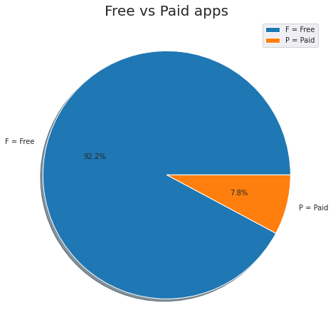
Here we can see from all app 92.2% app are free app & only 7.8% app are paid app.

Slide 9
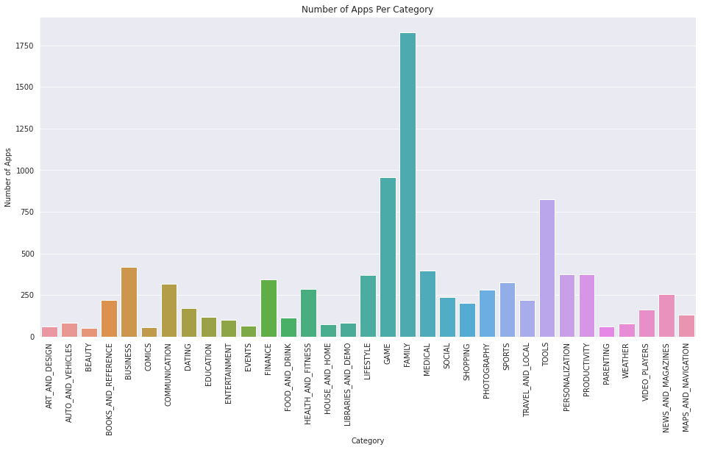
Here we see that there are highest no of app in play store from family category, followed by game then tools.

Slide 10
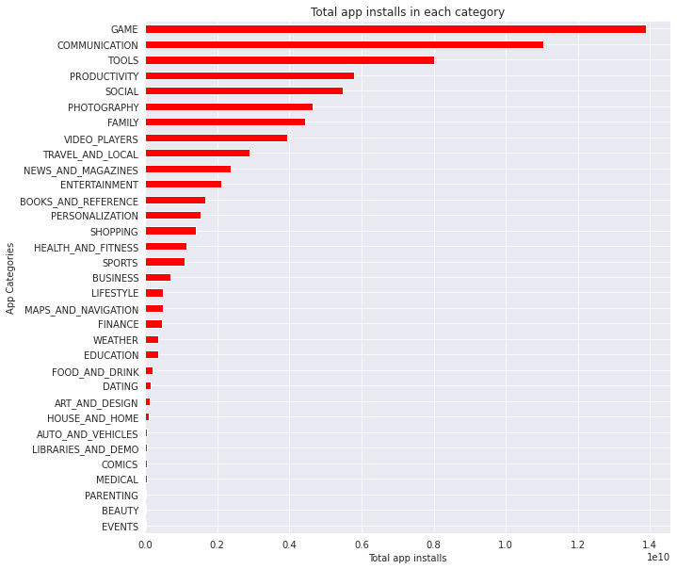
Here we can see that game category is the best install category among all

Slide 11
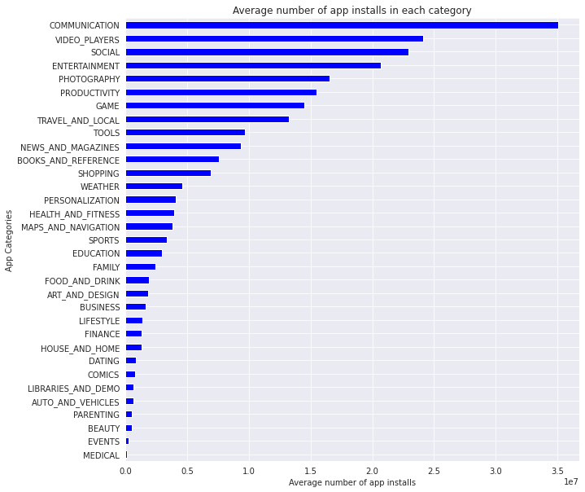
The Communication, Video Players, and Social category has the highest number of average app installs

Slide 12
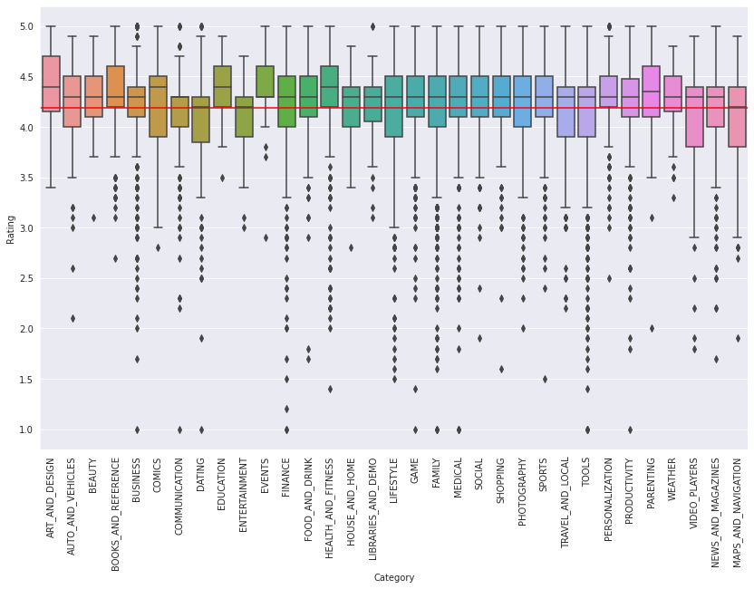
Highest quality apps with 50% apps with a rating higher than 4.5 are Health and Fitness and Book and Reference app. This is considered to be extremely high! However, the apps in Dating category having lower rating than the average ratings is 50%.

Slide 13
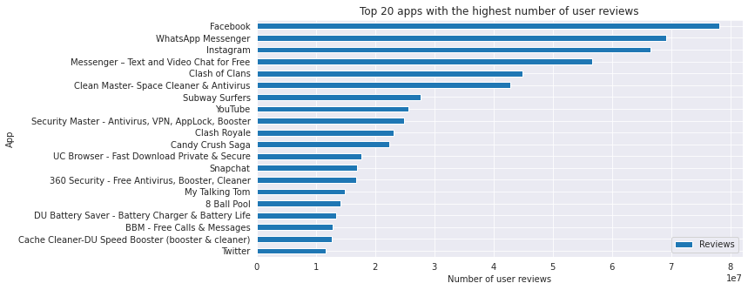
Number of user reviews indicates that these individuals have engaged with app

Slide 14
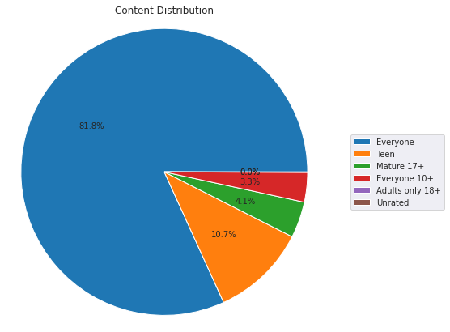
Almost 82% app is for Everyone and 10.7% for Teen.

Slide 15
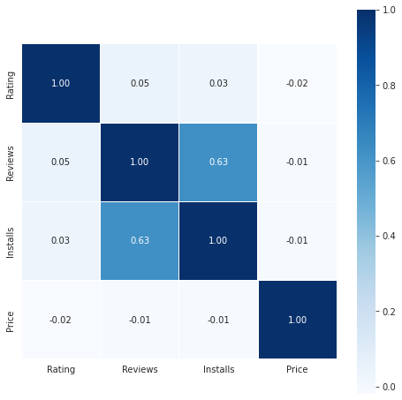
Correlation Heatmap
We can say that Free app
has good installs,
reviews and ratings in
comparison
to paid apps.
Paid app is negatively
Correlated with installs
Installs is positively
Correlated with reviews
Reviews is positively
Correlated with rating

Slide 16
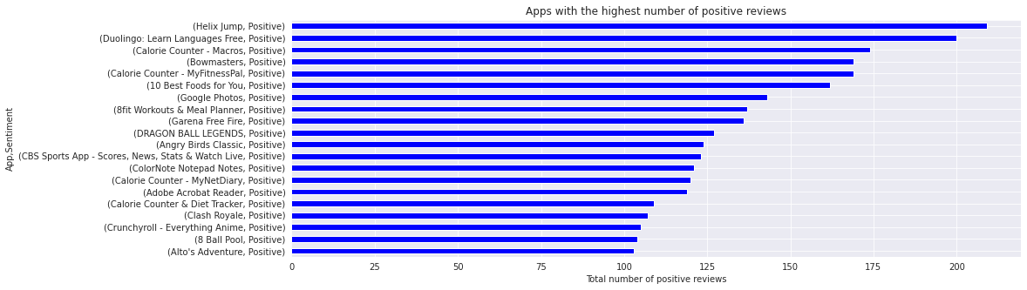
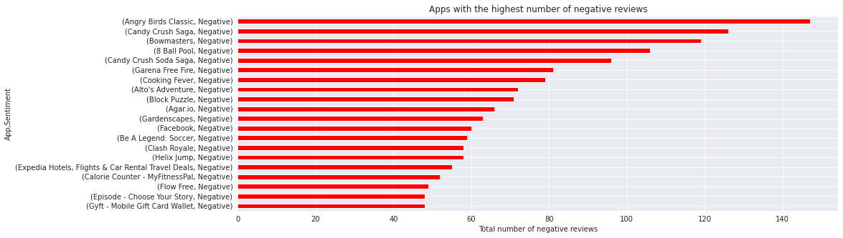
Positive and Negative Reviews

Slide 17
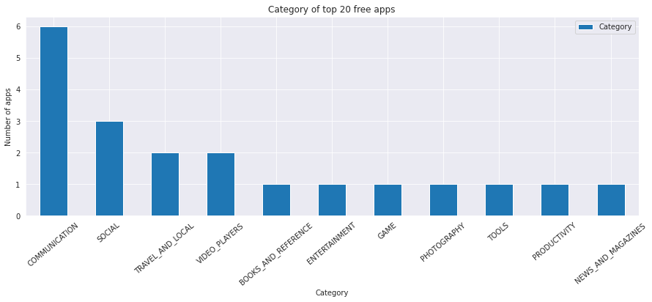
In top 20 apps category- Communication category is most dominating followed by social category

Slide 18

Thank you..!!

